Slide 1
The NPD Group - Enterprise DC Agenda
Business continuity enabled through geographically dispersed Data Center Access –
Remote Site Dynamic Multipoint VPN services with geographically dispersed WAN hub access
Cloud Aggregation providing hybrid compute services
Data Center availability through stretch vlan extension technologies- VxLAN

Slide 2
Business continuity through diverse Data Center Access
ISP Strategy allowing level-1 peering to drive latency optimization for SaaS offering and client remote services
Global web services/ business continuity through enabling GSS technologies using AnyCast to drive front-end efficiencies- aligning nicely with hybrid deployments supporting physical and cloud infra
Diverse BGP Peering enabling coupled with IXP’s allowing for flexible/ low latency Internet edge services
Leveraging BGP longest match, as path and communities to influence routing rules to enable coupled with BFD to enable highly available DC services

Slide 3
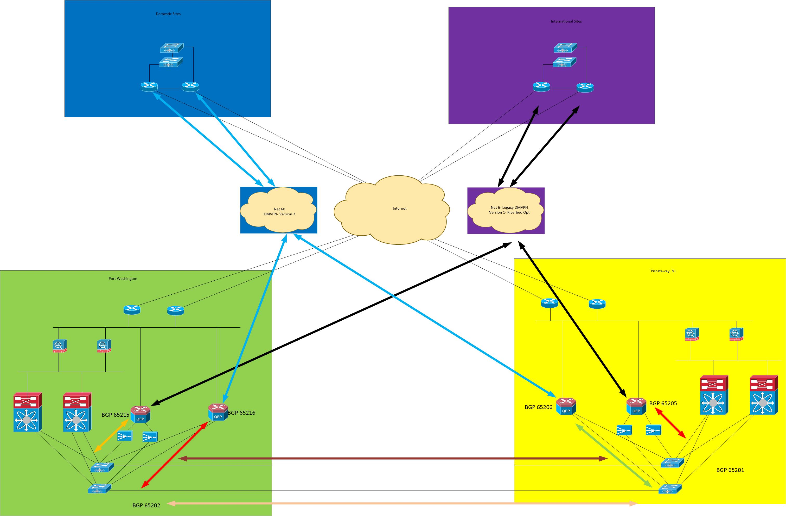
SDWAN/DMVPN global infra

Slide 4
VPN – SDWAN technologies
Highly available BGP Services aligned to Multi-hub DC strategy enabling global deployment- high availability;
based on open-standards leveraging simplified cookie-cutter design- plug and play model to simplify remote site onbaording
BGP Router Reflectors with multipoint connectivity streamlining remote site to remote site IP Services
Enabling transparent firewall layer 2 services while providing a centralizing mgmt / operations platform while performing various layers of packet inspection
Remote office turn-up / simplifying client onboarding leveraging self-deployment to provide configuration template coupled with overlay routing technologies to influence path selection based on application policies
Utilizing pro-active monitoring with Thousand Eyes to provide Internet brown-out path visualization to tactically identify soft failures
Traffic Engineering enabling higher preference coupled with more flexibility for production/ client facing workloads

Slide 5
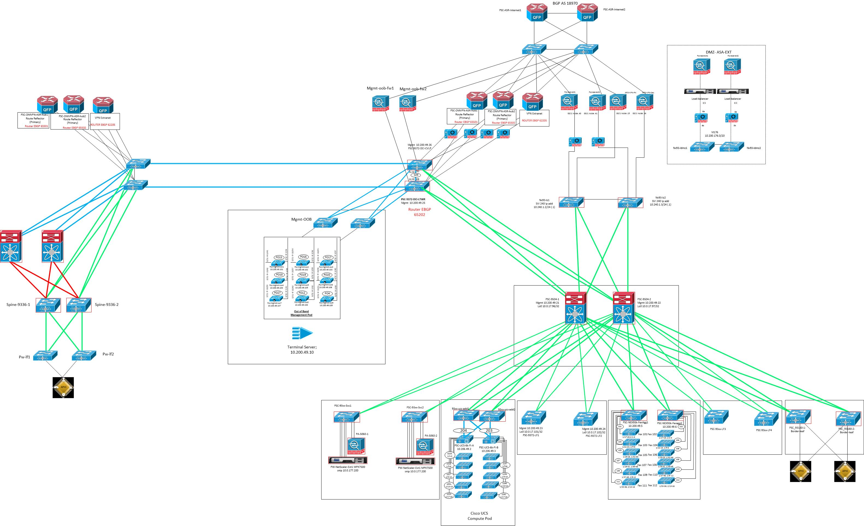
Data Center Framework

Slide 6
Cloud Services- DC Access
Considerations for cloud deployments;
Front end web services enabled through global load balancers allowing for geo access while enabling AnyCast routing technologies for longest match rules
Leveraging various cloud technologies through cloud exchanges allowing for direct connect to help backhaul large data sets
Leveraging full stack automation technologies enabling software driven router enablement
Evaulating White-box offering for full range of services; Firewalling-IPS-MW, Load-Balancing, routing and rich services to enable programmable, flexible client service
IXP services to enable high performance feature rich vpn backhaul services to drive cost optimized solution while connecting into the various cloud exchanges

Slide 7
DC Availability/ Automation
Current technology set drives issues around availability and being able to maintain flying the plane 30,000 feet in the air while be able to provide ultra high availability-
movement toward spine/ leaf with layer 3 bgp services leveraging EVPN labels for VxLAN
Vendor strategy has balance between API Restful infrastructure enabling programmability requiring closer vendor alignment vs open programmability through puppet/ chef and similar tool-sets
Being very data driven more aligned to bare-metal is key to network flexibility. Enablement of vxlan allowing stretch vlan across physical boundaries. Multi-vendor is key to strategy and closed technologies often pose challenge's with stack integrations
Restful API has critical role to enable IaaS/ PaaS services. Visibility is key to allow for exposure for traffic flow/ queue utilization where this often results in potential brownouts-

