Slide 1
Mythbusters 2
Cable Myths
Tim Stronge & Alan Mauldin
TeleGeography

Slide 2
Presenter Profile
Since joining the company in 2000, Mr. Mauldin has served as a principal analyst in many areas of TeleGeography’s research, including international Internet infrastructure, submarine cable systems, and bandwidth demand modeling.
Alan made the Kessel run in less than 12 parsecs.
Contents
Alan Mauldin
Research Director
amauldin@telegeography.com

Slide 3
Presenter Profile
Since joining TeleGeography in 1996, Tim has served as a principal analyst in most areas of research, including network infrastructure, bandwidth demand modeling, cross-border traffic flows, and telecom services pricing.
Tim has the death sentence on 12 star systems.
Contents
Tim Stronge
VP—Research
tstronge@telegeography.com

Slide 4
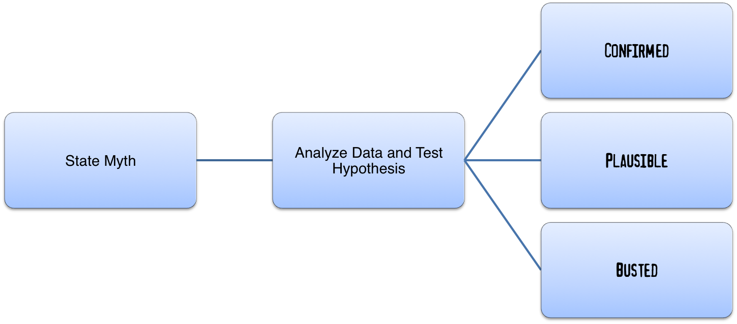
Revenge of the Cable Myths
What is mythbusting?

Slide 5
Mass Surveillance Myth
The Myth: Cables that avoid U.S. territory are free from mass surveillance
Conclusion: ???
Status: ???

Slide 6
Mass Surveillance
Concept is nothing new: “Panopticon”

Slide 7
Mass Surveillance Myth
Methodology
Definition
Surveillance of an entire or a substantial fraction of a population
Optical or IP layer
Approach
Determine if there are other countries besides the U.S. engaging in mass surveillance
Cite only publicly-available information
Conditions
I’m not claiming that all countries' surveillance capabilities are equal
I’m not weighing in on whether mass surveillance is "good" or "bad"

Slide 8
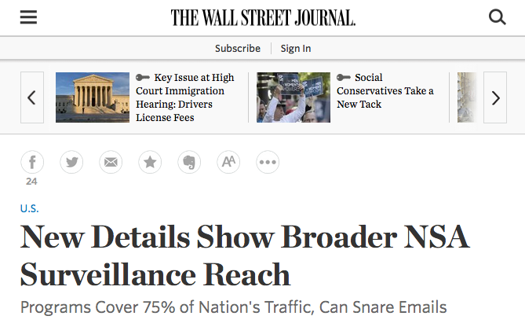
Mass Surveillance
Computing power has allowed for advances

Slide 9
MISSION ACCOMPLISHED, PEOPLE

Slide 10
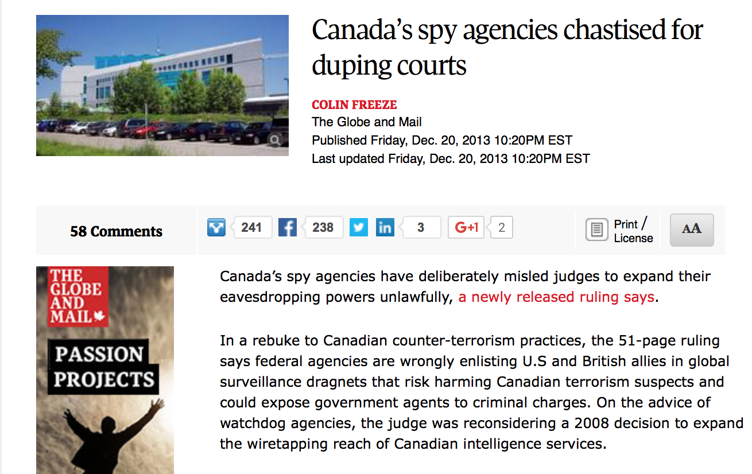
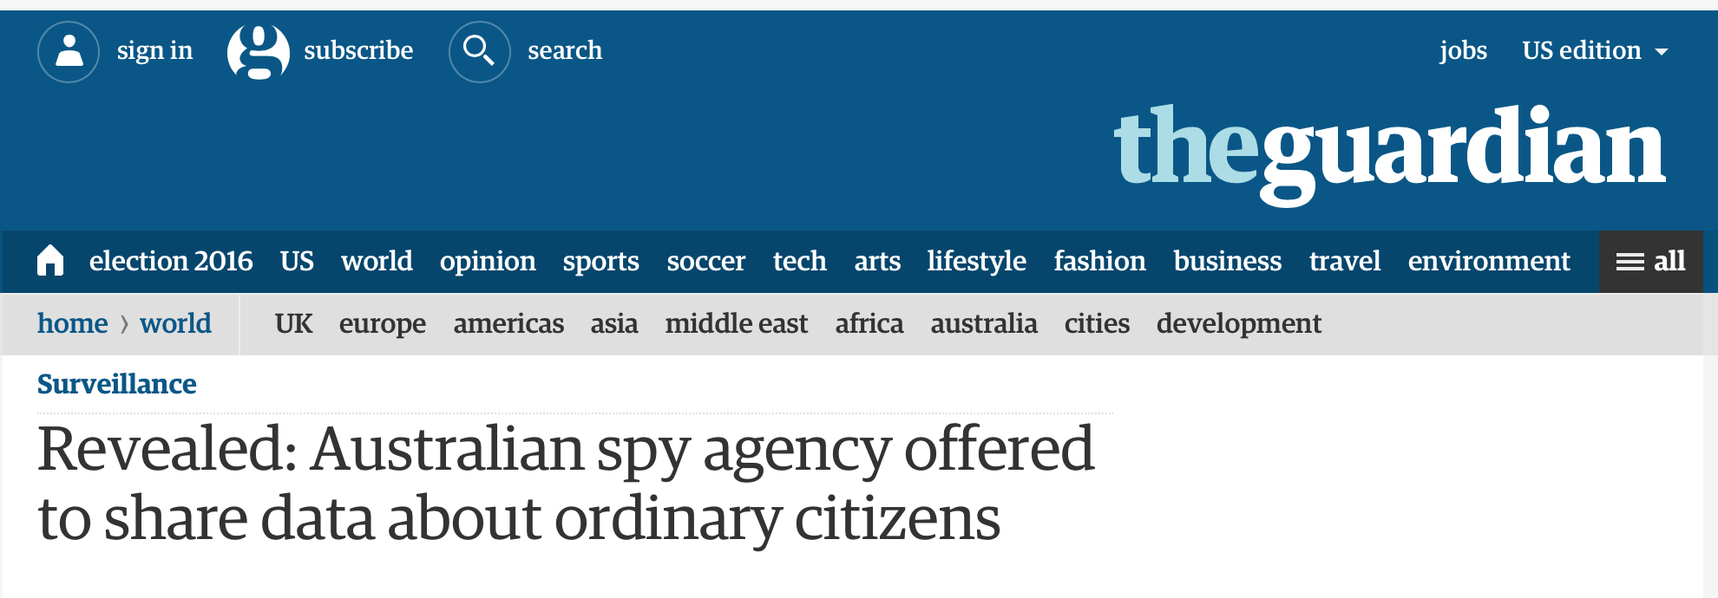
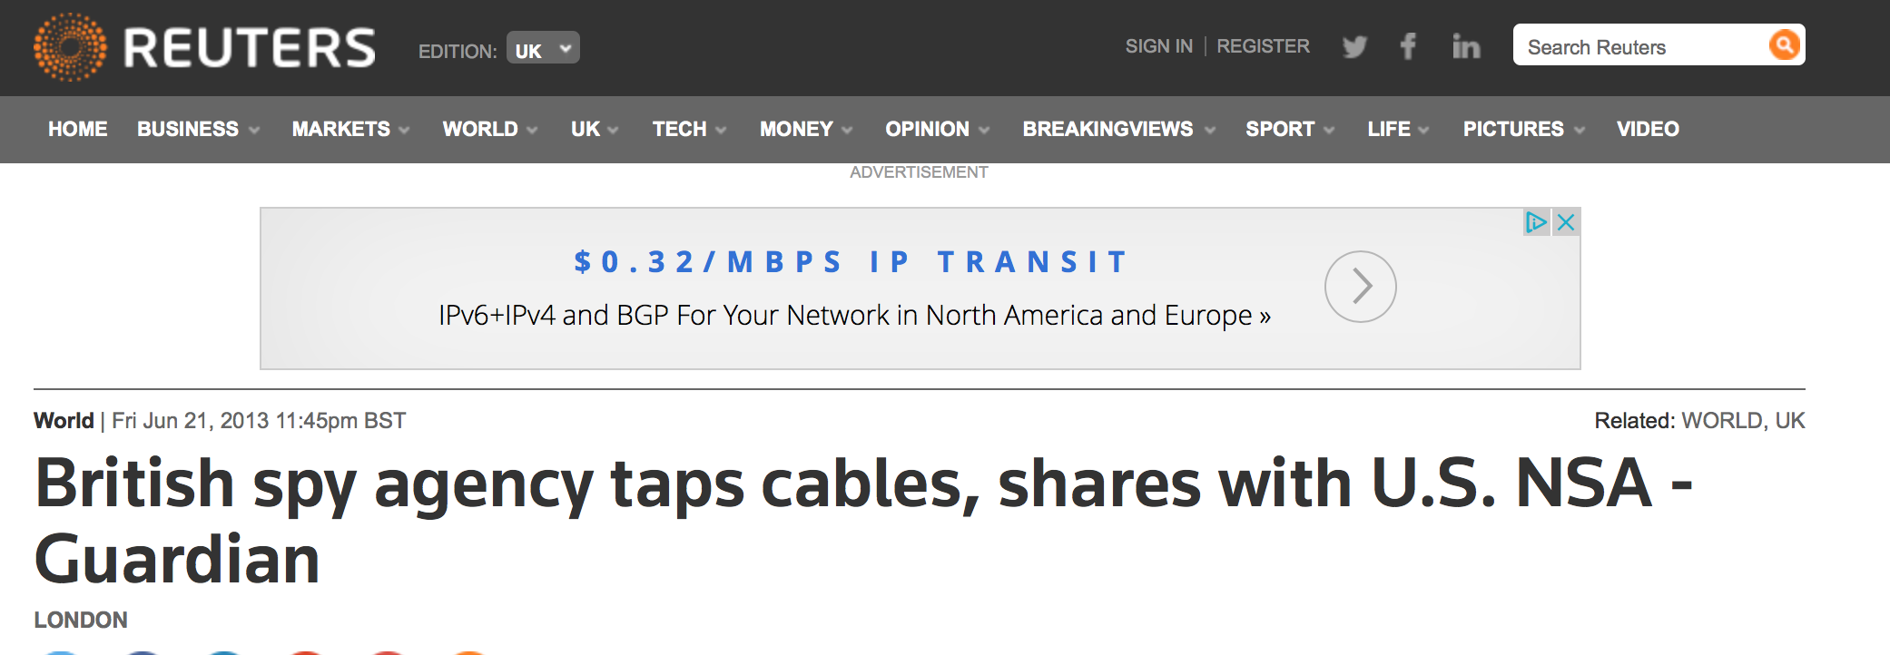
Mass Surveillance
Five Eyes

Slide 11
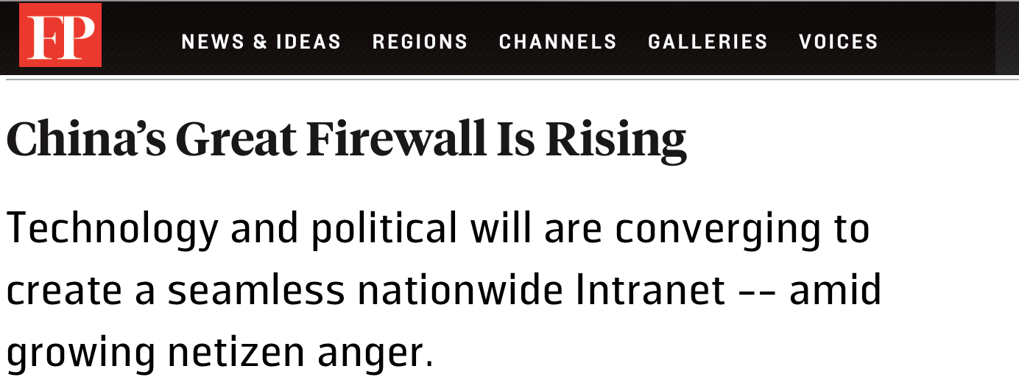
Mass Surveillance
The Commies are pretty good at this, too

Slide 12
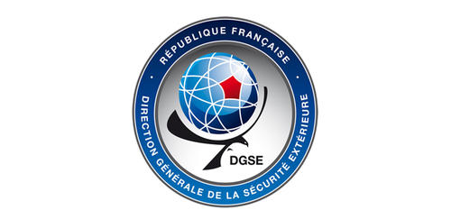
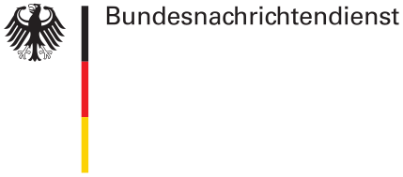
Mass Surveillance
Even NSA critics want in on the game
Notes:
New French law:
* It also requires internet service providers to collect metadata, which is then processed by an algorithm to detect strings of suspicious activity—a page taken right from the NSA’s playbook
* Instead of requiring a judge’s approval, security officials can under the new law order surveillance after advice by a newly created supervisory body specifically dedicated to such approvals.
* The legislation, which was passed by French parliament in May, drew such strong opposition from the public that France President François Hollande referred it to the nation’s Constitutional Council, which finally gave it the go-ahead in July.
Germany
Intercept at DE-CIX Frankfurt and several other Internet exchanges
* German Foreign Intelligence Agency Bundesnachrichtendienst (BND) is allowed to wiretap 25 Internet Service Providers at DE-CIX, including five German IXP and the traffic of multiple vendors
* Some German traffic caught up in this mass surveillance, but mainly aimed at traffic from Africa, Middle East, and Russia

Slide 13
Mass Surveillance
Even NSA critics want in on the game

Slide 14
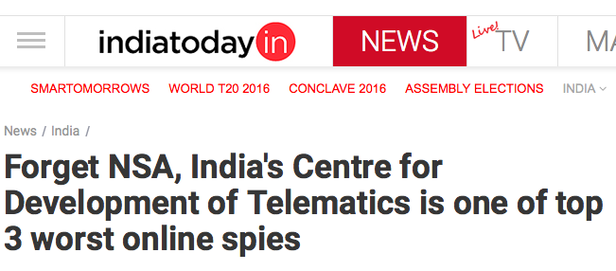
Mass Surveillance
India’s in on it, too

Slide 15
Mass Surveillance
To be safe …
Source: TeleGeography

Slide 16
Mass Surveillance
… let’s avoid the U.S.
Source: TeleGeography

Slide 17
Mass Surveillance
… and Canada
Source: TeleGeography

Slide 18
Mass Surveillance
… and Australia and New Zealand
Source: TeleGeography

Slide 19
Mass Surveillance
… and the U.K.
Source: TeleGeography

Slide 20
Mass Surveillance
… and Russia & the C.I.S.
Source: TeleGeography

Slide 21
Mass Surveillance
… and France
Source: TeleGeography

Slide 22
Mass Surveillance
… and India
Source: TeleGeography

Slide 23
Mass Surveillance
… and Bahrain
Source: TeleGeography

Slide 24
Mass Surveillance
… and China
Source: TeleGeography

Slide 25
Mass Surveillance
… and Germany
Source: TeleGeography

Slide 26
Mass Surveillance
Maybe we shouldn’t talk at all?

Slide 27
Mass Surveillance Myth
The Myth: Cables that avoid U.S. territory are free from mass surveillance
Conclusion: Mass surveillance of communications is widespread
Status: ???

Slide 28
Post-Snowden Myth
The Myth: Internet providers around the world have become less reliant on the U.S. as a result of the Snowden revelations
Conclusion: ???
Status: ???

Slide 29
Post-Snowden Myth
Methodology
Examine layer 3 (IP) connectivity patterns
Determine whether global Internet became less U.S.-centric after 2012

Slide 30
Internet Capacity Connecting to the U.S.
2003-2012
Source: TeleGeography

Slide 31
Internet Capacity Connecting to the U.S.
2003-2012 + Trendline Projections
Source: TeleGeography

Slide 32
Internet Capacity Connecting to the U.S.
2003-2015: Trendline Projections vs. Reality
Source: TeleGeography

Slide 33
Internet Capacity Connecting to the U.S.
2015 Global Average
(2012 Projection):
28%
2015 Global Average
(2015 Actual):
30%
Source: TeleGeography

Slide 34
Post-Snowden Myth
But that was just IP-layer connectivity
IP connections tend to mirror transport layer availability
What about end-to-end traffic?

Slide 35
Post-Snowden Myth
Methodology Part II
End-to-end traffic patterns very difficult to collect
But we can use the following as a proxy:
Determine most popular websites for users in each country (source: Alexa)
Query domain name servers (DNS) in each country
Look up IP addresses of the most popular websites
Use GeoIP databases to look up server location of those IP addresses (source: Geolite)

Slide 36
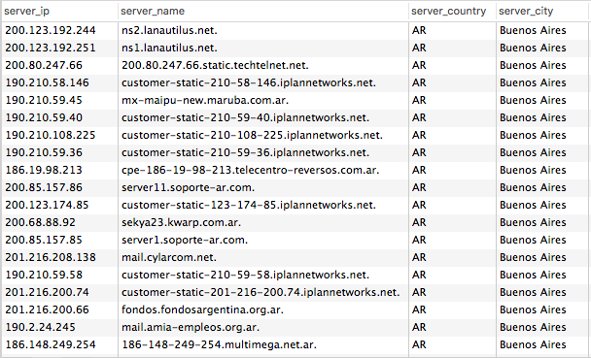
Internet Content Served from the U.S.
Top Sites
Domain Name Server Locations
x

Slide 37
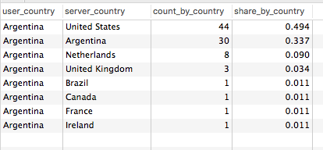
Internet Content Served from the U.S.
Results
Summary
Source: TeleGeography

Slide 38
Internet Content Served from the U.S.
Users in
Hosted in
Source: TeleGeography

Slide 39
Post-Snowden Myth
Summary
As a % of global total, IP capacity to the U.S. has decreased since Snowden
But decrease was already happening
And decrease has been less than historical trends
User-to-server patterns still center on U.S.
Even countries w/o direct connections to North America hop to U.S. servers

Slide 40
Post-Snowden Myth
The Myth: Internet providers around the world have become less reliant on the U.S. as a result of the Snowden revelations
Conclusion: The U.S. remains a central node of the global Internet
Status:

Slide 41
Shark Myth
The Myth: Sharks pose the greatest danger to undersea cable infrastructure
Conclusion: ???
Status: ???

Slide 42
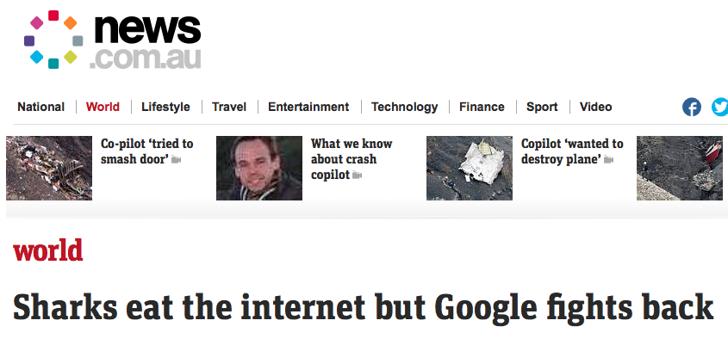
Shark Myth: Recent News Stories

Slide 43
Shark Myth: Research

Slide 44
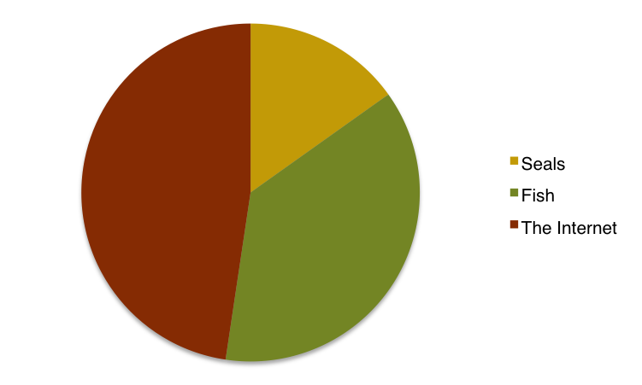
Shark Myth: Research Results
What Sharks Eat
Source: Cold, hard science

Slide 45
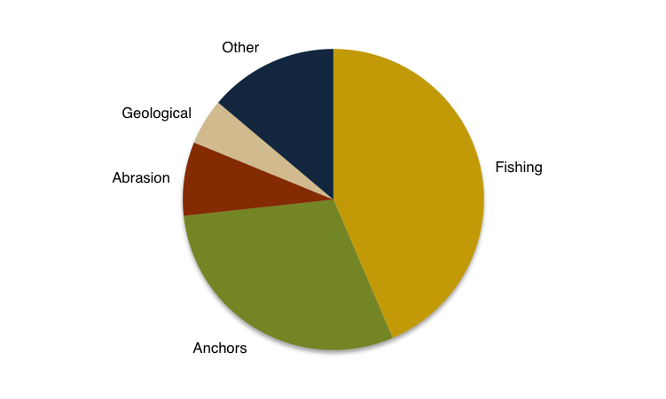
Shark Myth
Cause of External Aggression Cable Faults, 2007-2009
Source: Trends in Submarine Cable System Fault, M. Kordahi, S. Shapiro, & G. Lucas

Slide 46
Shark Myth: A New Threat on the Horizon?

Slide 47
Shark Myth
The Myth: Sharks pose the greatest danger to undersea cable infrastructure
Conclusion: No. Monkeys do.
Status:

