Slide 1

Mythbusters 2
Cable Myths
Tim Stronge & Alan Mauldin
TeleGeography

Slide 2
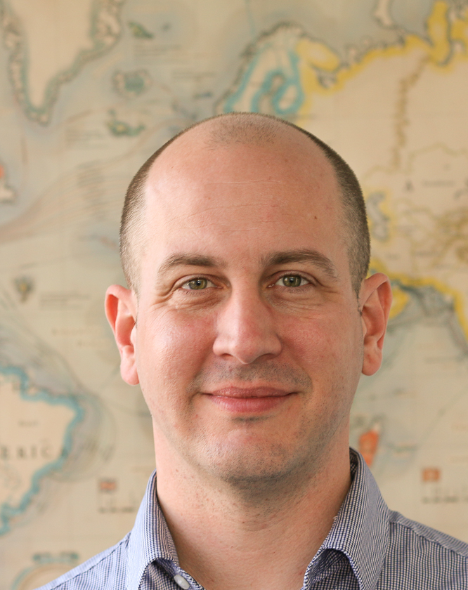
Presenter Profile
Since joining the company in 2000, Mr. Mauldin has served as a principal analyst in many areas of TeleGeography’s research, including international Internet infrastructure, submarine cable systems, and bandwidth demand modeling.
Alan made the Kessel run in less than 12 parsecs.
Contents
Alan Mauldin
Research Director
amauldin@telegeography.com

Slide 3

Presenter Profile
Since joining TeleGeography in 1996, Tim has served as a principal analyst in most areas of research, including network infrastructure, bandwidth demand modeling, cross-border traffic flows, and telecom services pricing.
Tim has the death sentence on 12 star systems.
Contents
Tim Stronge
VP—Research
tstronge@telegeography.com

Slide 4
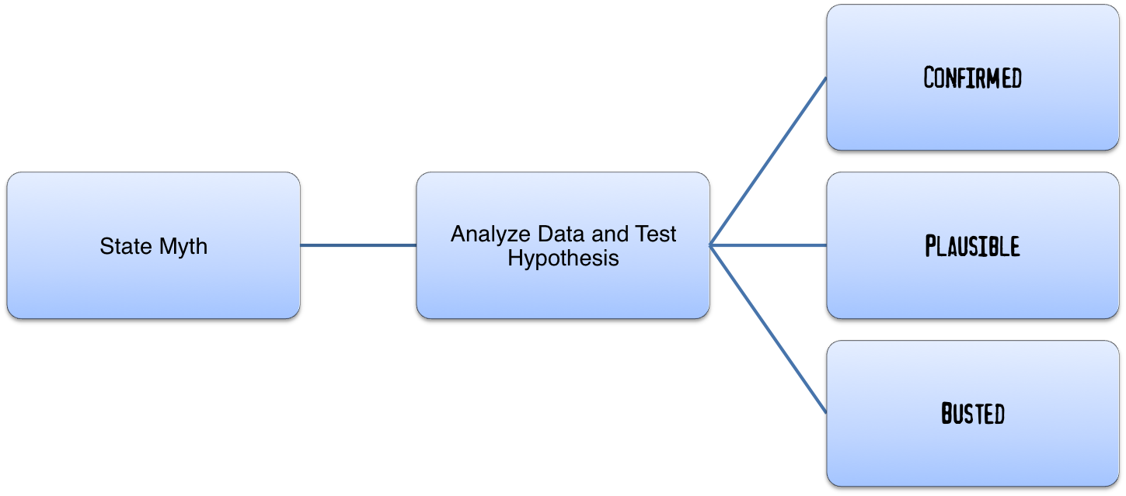
Revenge of the Cable Myths
What is mythbusting?

Slide 5
Demand Doubling Myth
The Myth: Demand for submarine cable capacity is doubling every 2 years.
Conclusion: ???
Status: ???

Slide 6
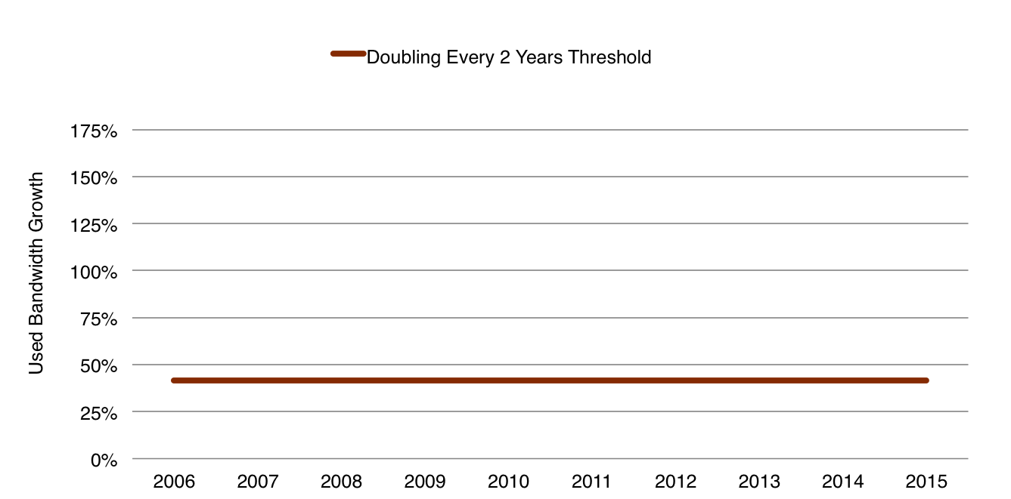
Demand Doubling Myth
What is “Doubling Every 2 Years” in Annual Terms?
~41% Annually
Source: TeleGeography

Slide 7
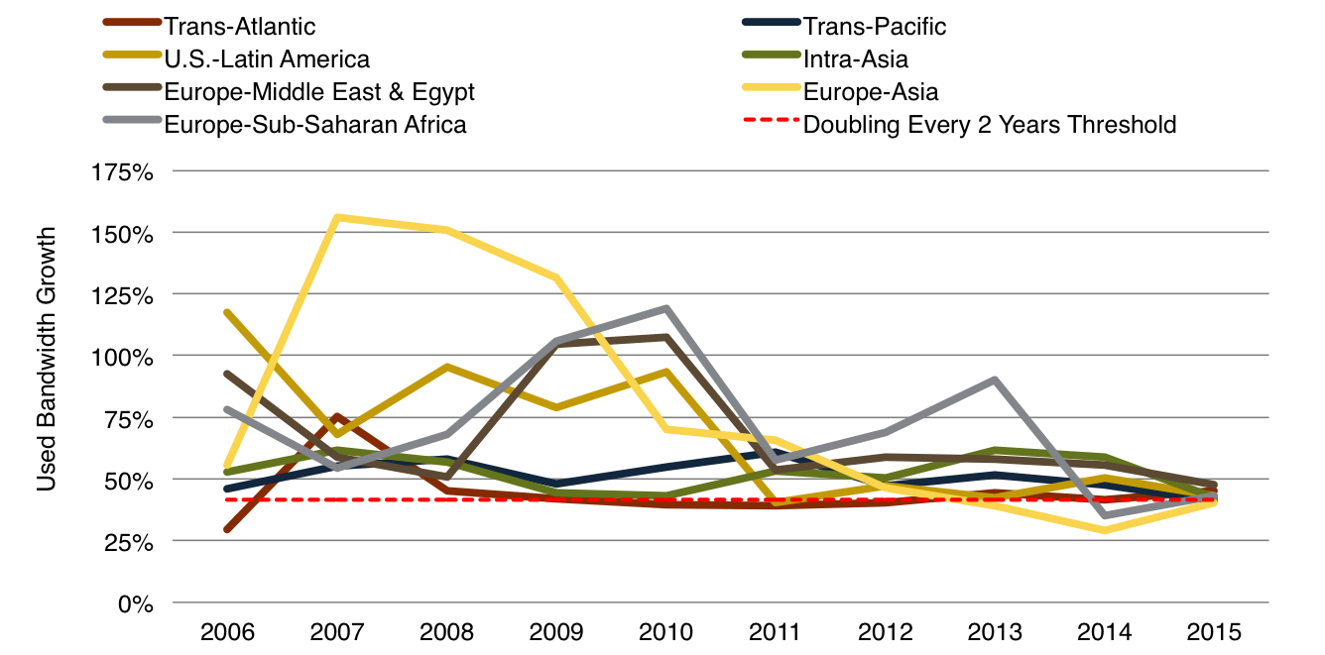
Demand Doubling Myth
Annual Demand Growth Generally >41%
Source: TeleGeography

Slide 8
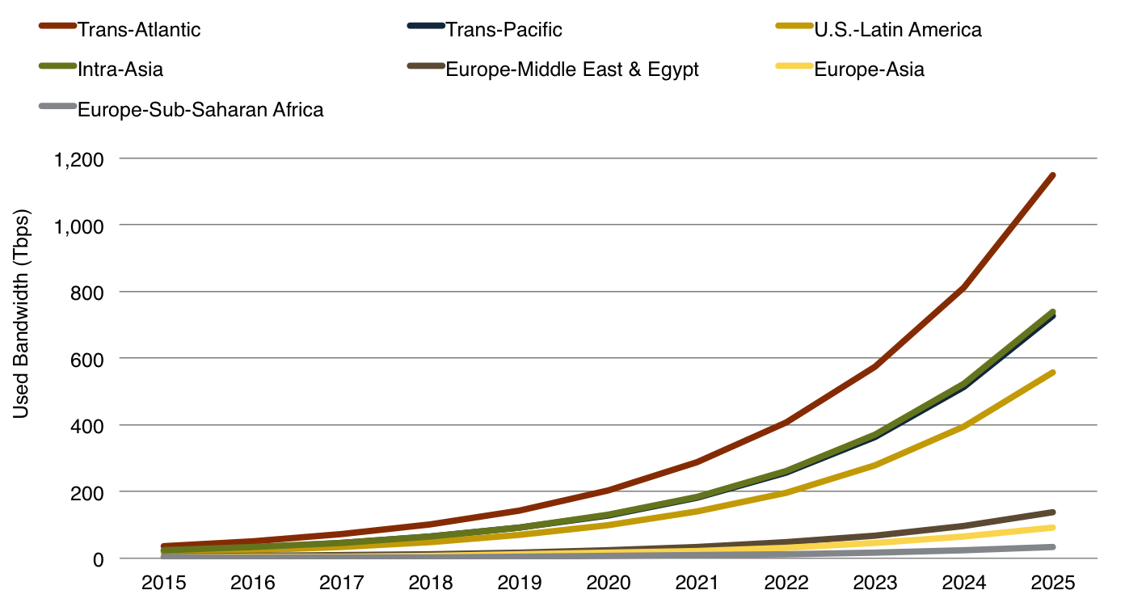
Demand Doubling Myth
What if this Pace Continues?
Source: TeleGeography

Slide 9

Demand Doubling Myth
The Myth: Demand for submarine cable capacity is doubling every 2 years.
Conclusion: On most routes demand continues to rise by more than 41% per year.
Status:

Slide 10
Content Provider Myth
The Myth: Content providers need fiber pairs everywhere
Conclusion: ???
Status: ???

Slide 11


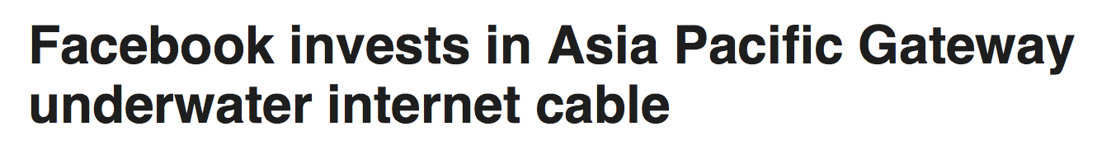
Content Provider Myth
Origin of the myth

Slide 12
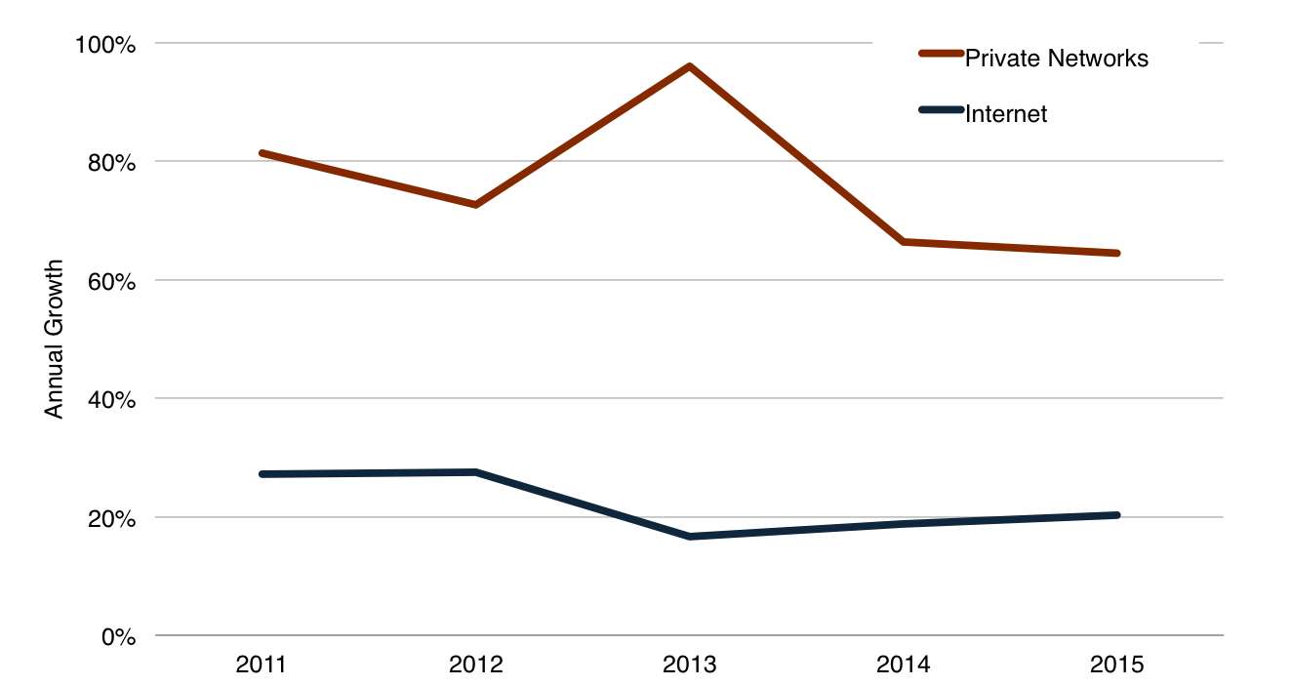
Content Provider Myth
Trans-Atlantic Demand Growth by Source
Source: TeleGeography

Slide 13
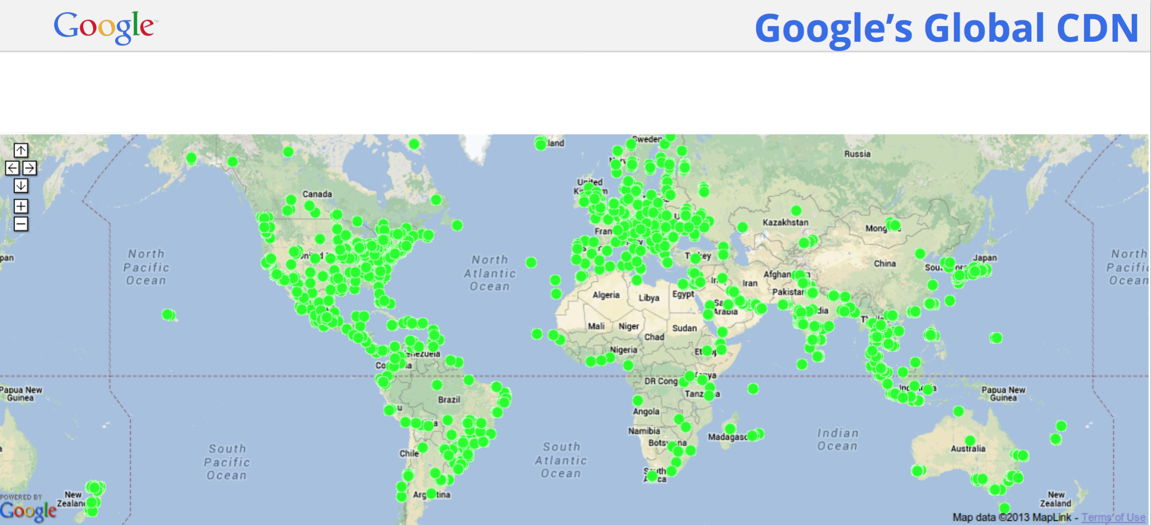
Content Provider Myth
Google is Everywhere!
Source: Bikash Kolay, Google, Software Defined Networking at Scale, BTE 2014

Slide 14
Content Provider Myth
Methodology
Plan A - Any content providers in the audience are invited to please explain their network topology, bandwidth requirements, and expansion plans in detail.
Plan B – examine any public information from content providers on their network deployments and growth patterns.

Slide 15
Content Provider Myth
Google has 2 networks: B4 and B2
  “...B4, provides connectivity among data centers, e.g., for asynchronous data copies, index pushes for interactive serving systems, and end user data replication for availability. Well over 90% of internal application traffic runs across this network.”
  B4 also “...now serves more traffic than our public facing WAN, and has a higher growth rate.”
Source: B4: Experience with a Globally-Deployed Software Defined Network, Google, ACM SIGCOMM 2013.

Slide 16
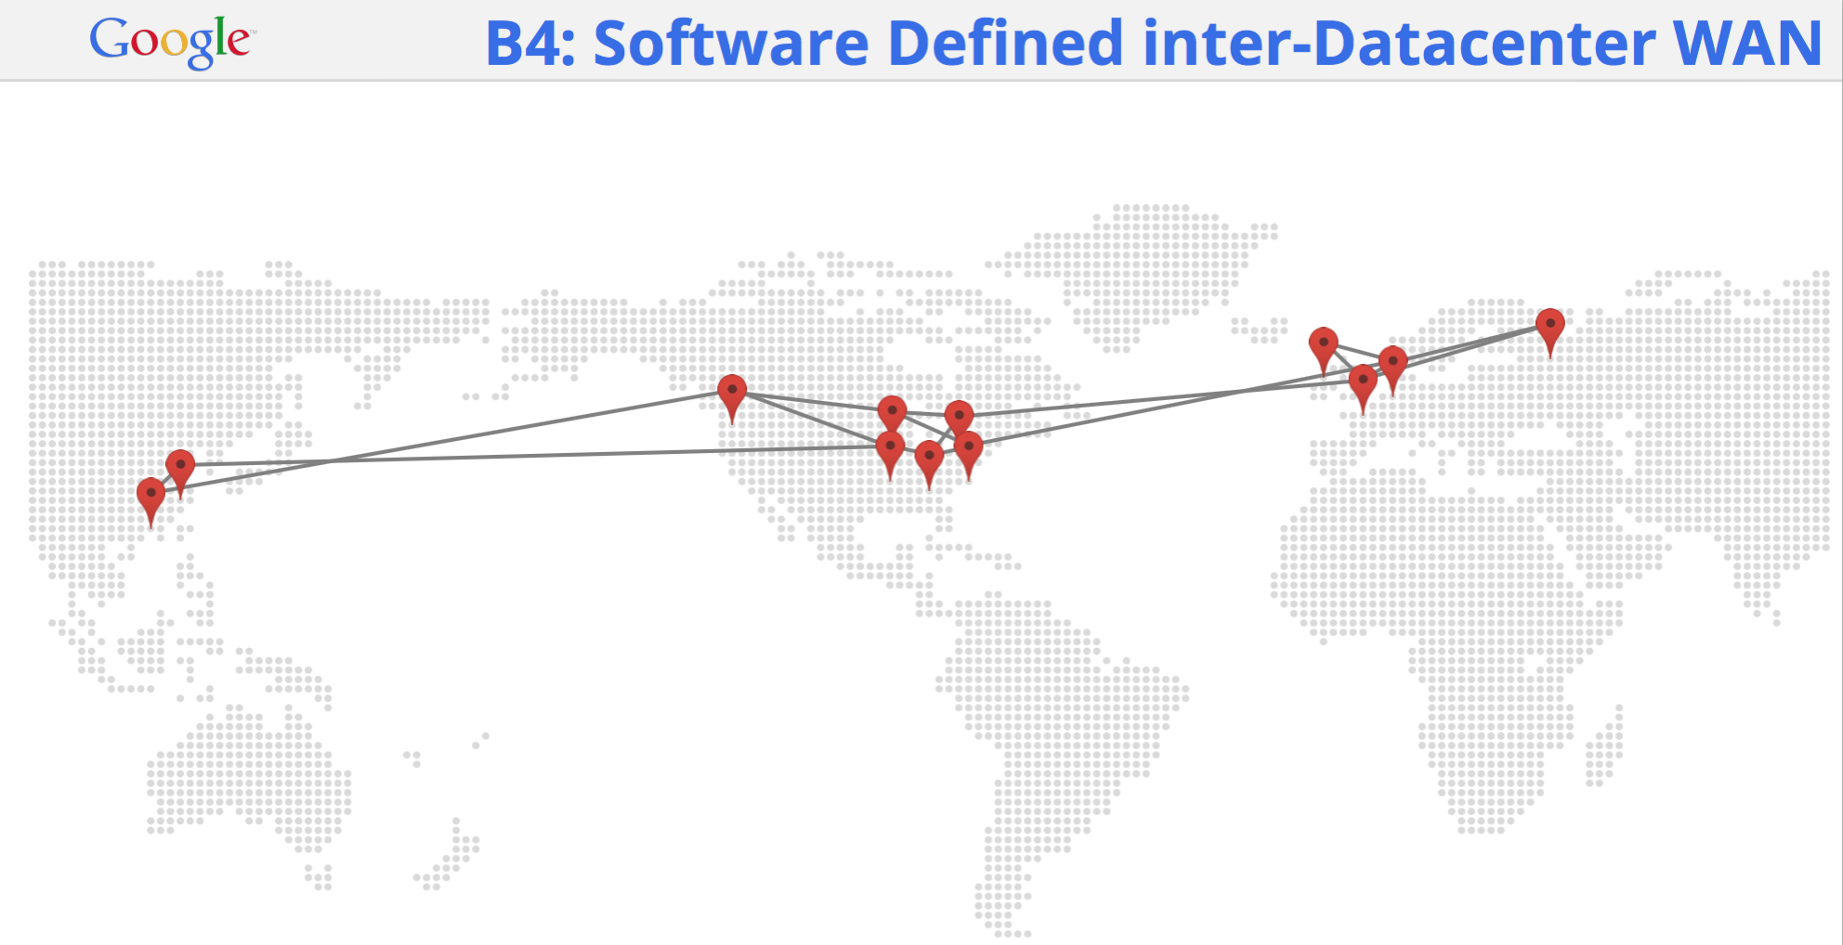
Content Provider Myth
Where is the B4 Network?
Source: Bikash Kolay, Google, Software Defined Networking at Scale, BTE 2014

Slide 17
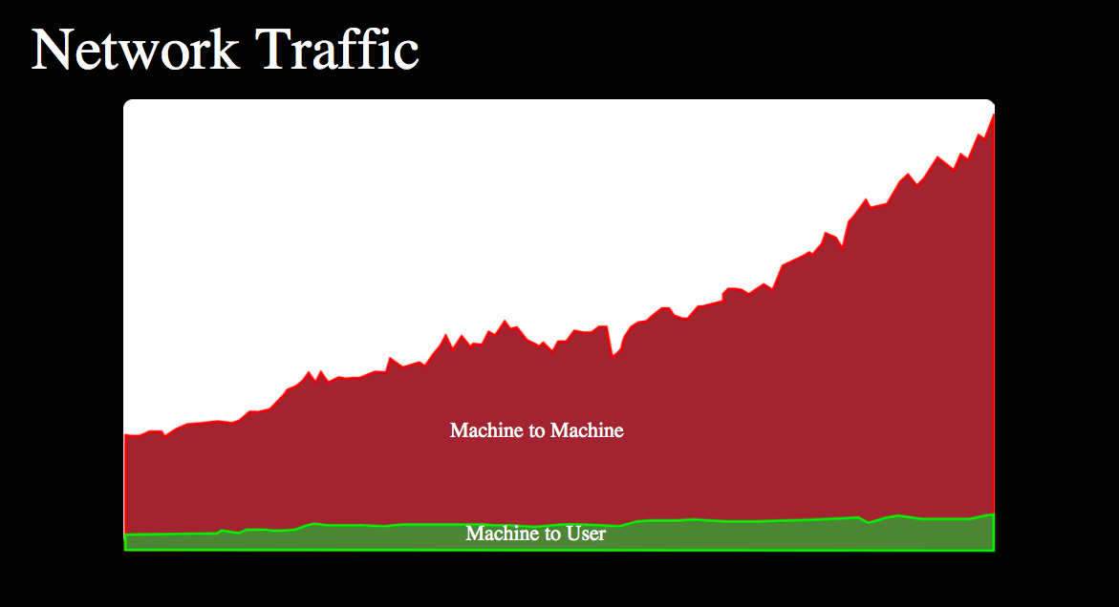
Content Provider Myth
The Situation is Similar for Facebook
Machine-to-Machine = Intra-data center and inter-data center
Source: Facebook, Gaya Nagarajan, NANOG61, 2014

Slide 18
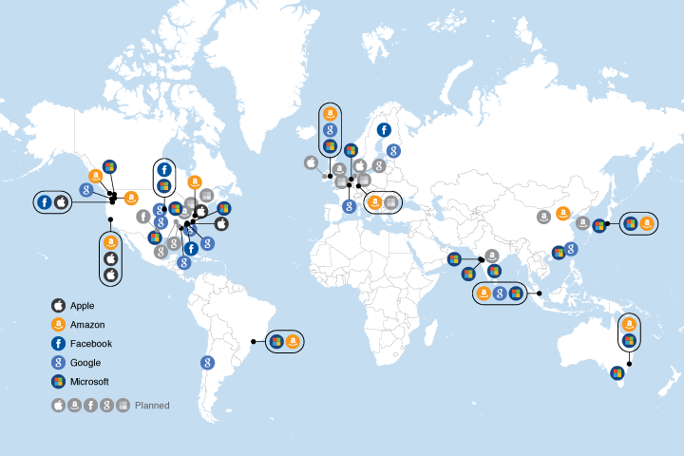
Content Provider Myth
The Location of Content Provider Data Centers Matters
Notes: Map only depicts major data center locations. These companies are also present at other locations. Planned locations are those expected to be active by 2017.
Source: TeleGeography from public sources.

Slide 19
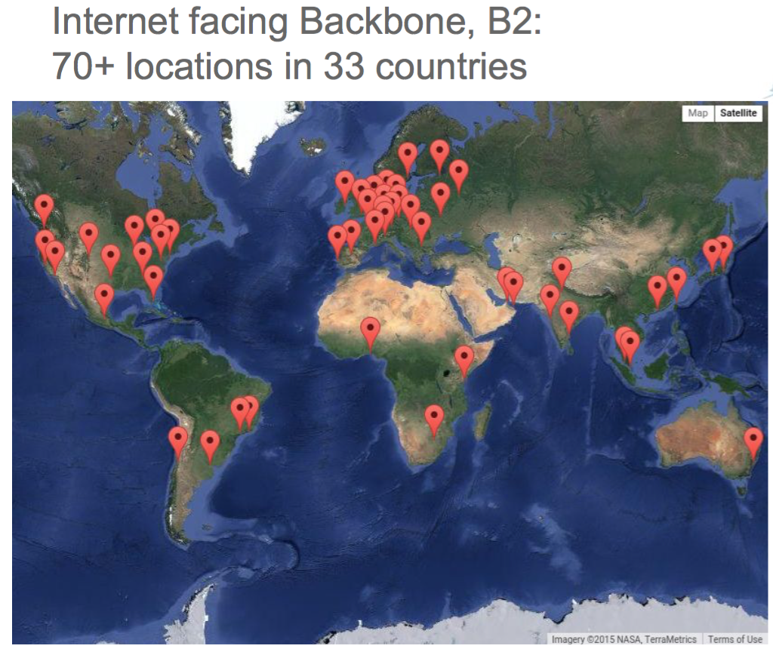
Content Provider Myth
Data Centers-to-Users is Not Insignificant
Source: Bikash Kolay, Google, BTE 2015

Slide 20
Content Provider Myth
Data Centers-to-Users is Not Insignificant
Source: Albert Greenburg, Microsoft, SDN for the Cloud, SIGCOMM 2015.

Slide 21
Content Provider Myth
Number of Countries per Region for Public or Private Peering
Source: PeeringDb, www.peeringdb.com, April 2016.

Slide 22
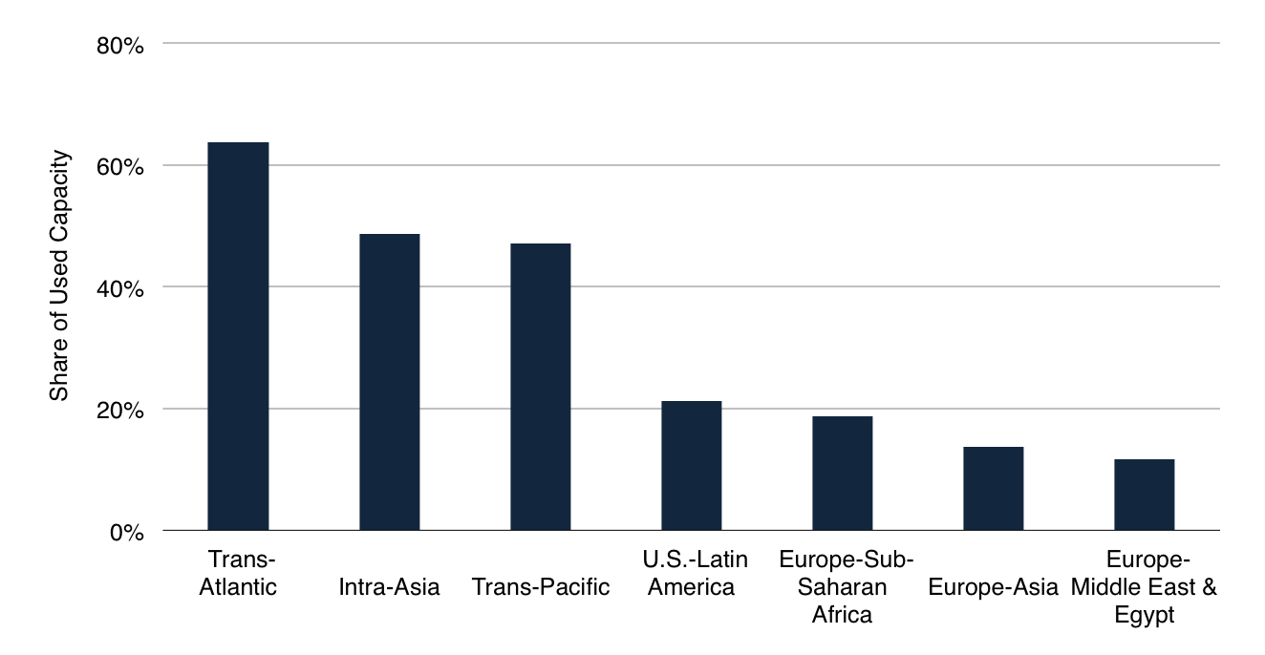
Content Provider Myth
Private Networks’ Share of Bandwidth by Route, 2015
Source: TeleGeography

Slide 23

Content Provider Myth
The Myth: Content providers need fiber pairs everywhere.
Conclusion: Content providers’ may have fiber-pair level requirements for inter-data center routes and data center-large user bases, but not “everywhere”....yet.
Status:

Slide 24
Diversity Myth
The Myth: The global network has never been more resilient.
Conclusion: ???
Status: ???

Slide 25
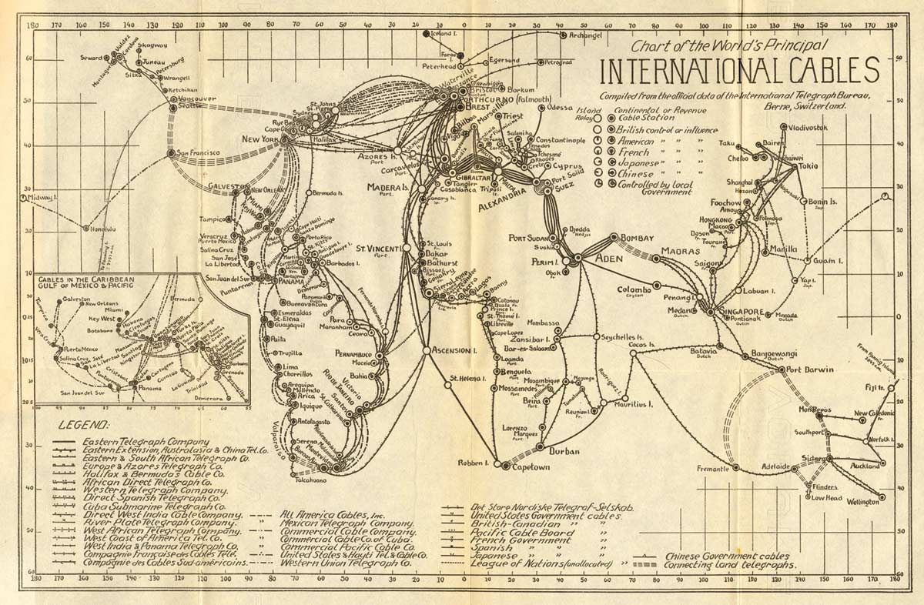
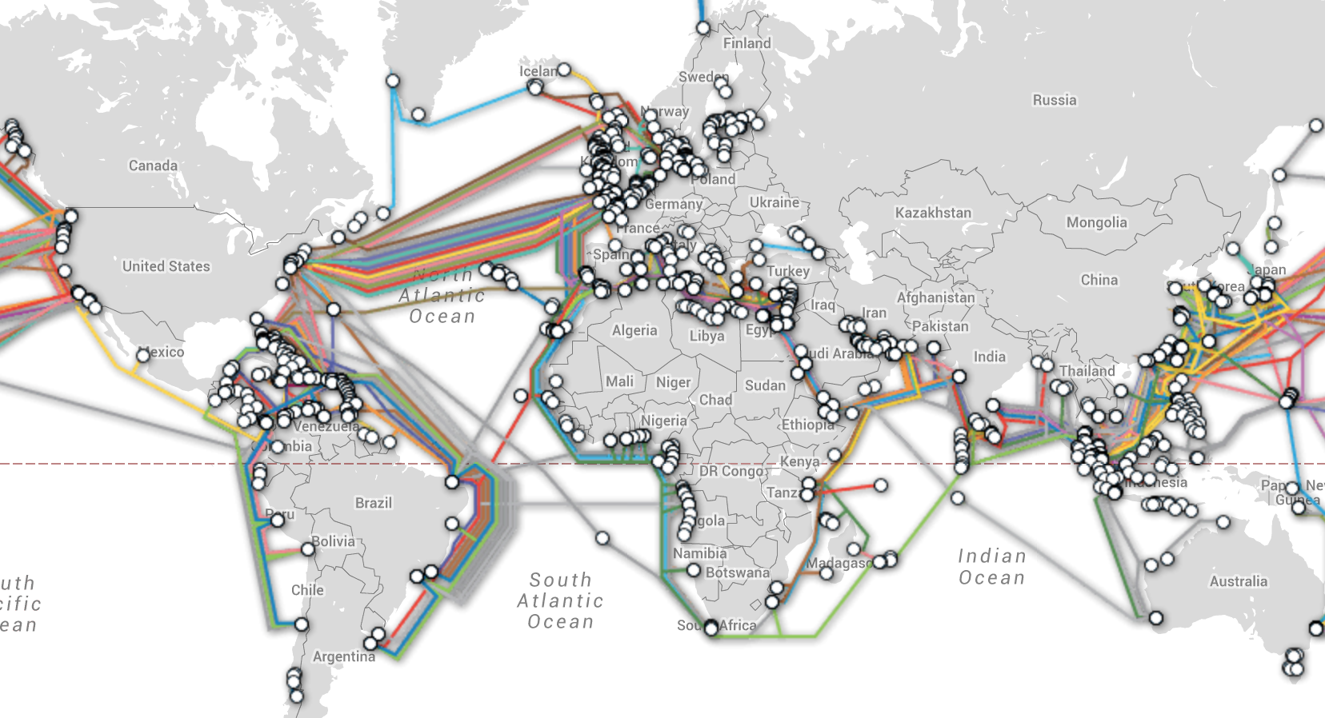
Diversity Myth
Methodology
1924
2016
Source: International Telegraph Bureau, Bern, Switzerland, 1924
Source: TeleGeography’s Interactive Submarine Cable Map (www.submarinecablemap.com)

Slide 26
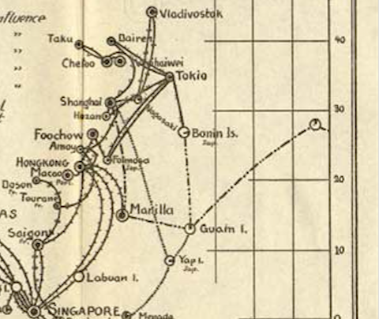
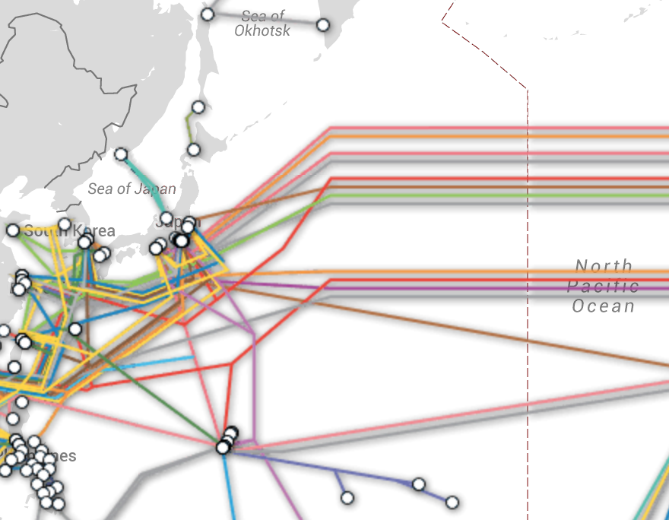
Diversity Myth
Northern Trans-Pacific
1
11 (+ 4 planned)

Slide 27
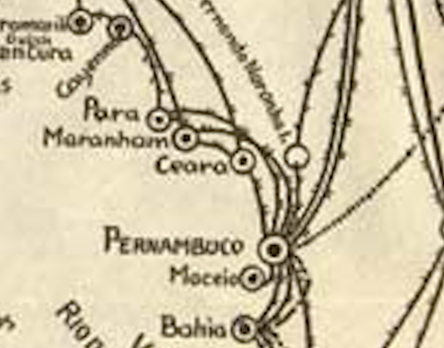
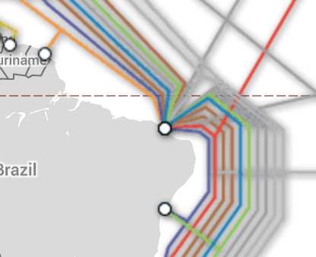
Diversity Myth
U.S.-Brazil
3
6 (+ 3 planned)

Slide 28
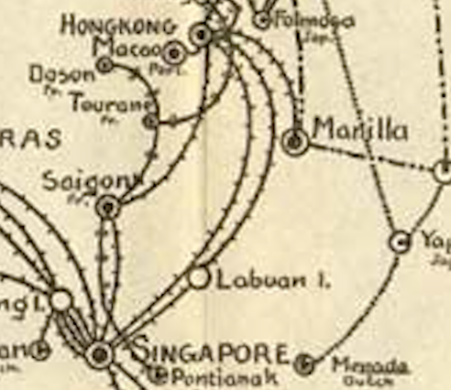
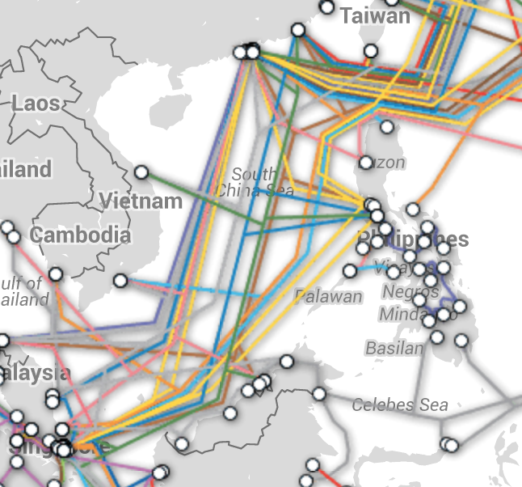
Diversity Myth
Hong Kong-Singapore
2
10 (+ 2 planned)

Slide 29
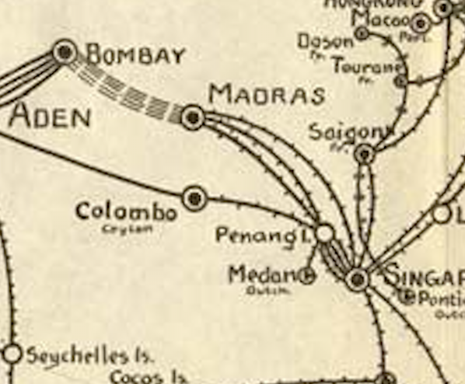
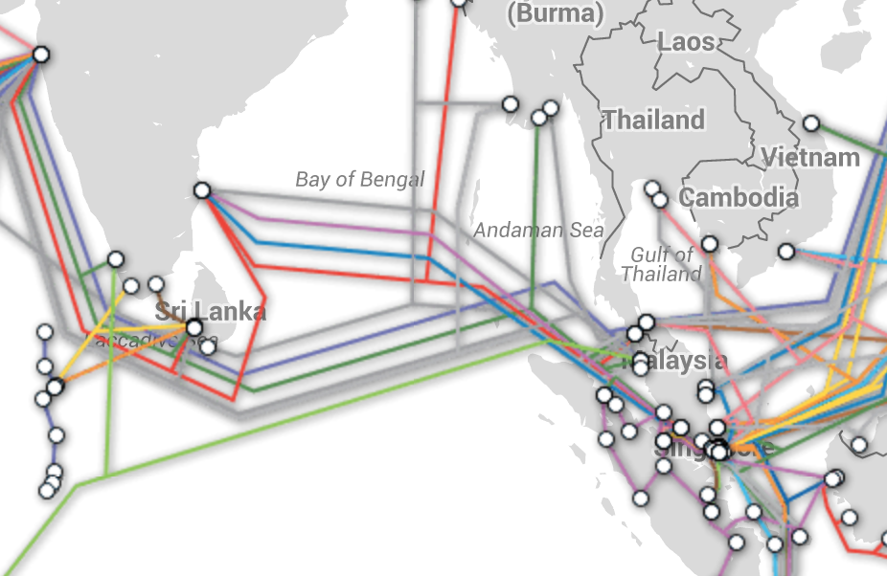
Diversity Myth
India-SE Asia
3
6 (+2 planned)

Slide 30

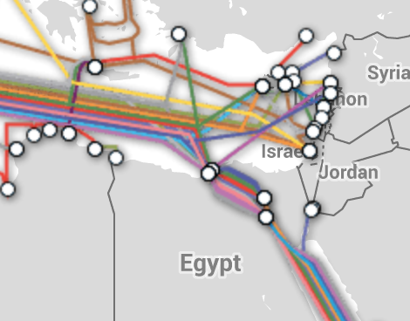
Diversity Myth
Europe-Egypt
6
8 (+2 planned)

Slide 31
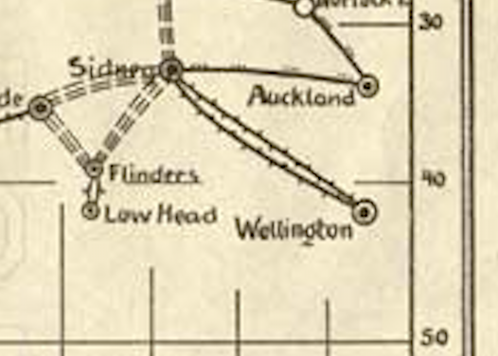
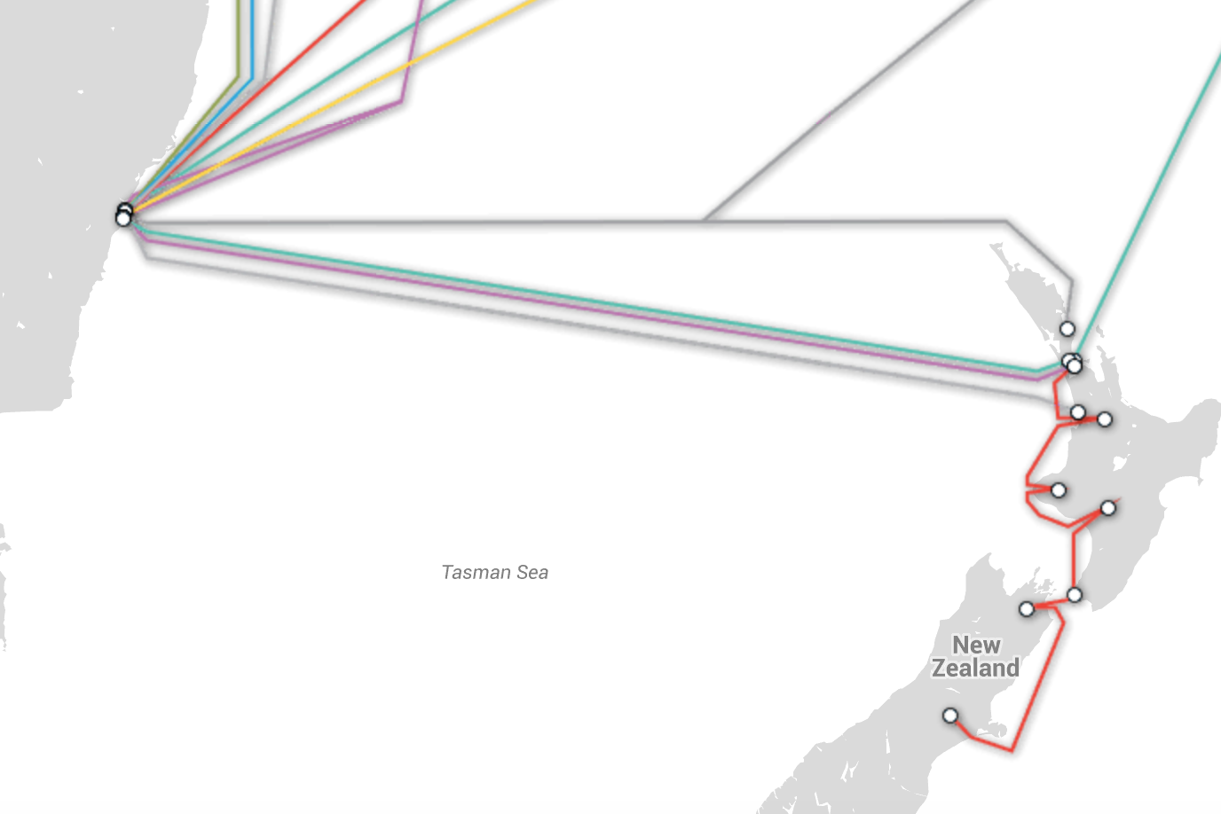
Diversity Myth
Trans-Tasman
3
2 (+2 planned)

Slide 32
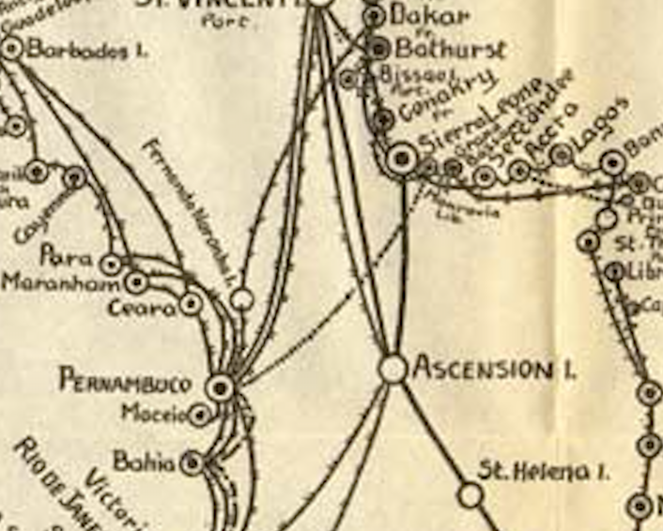
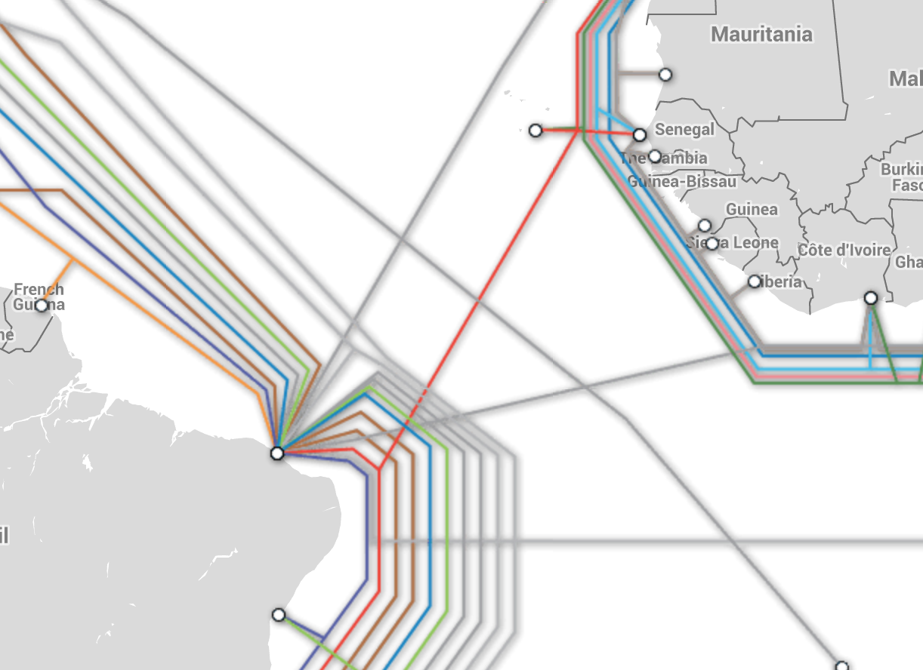
Diversity Myth
South America-Africa
3
1 (+2 planned)

Slide 33
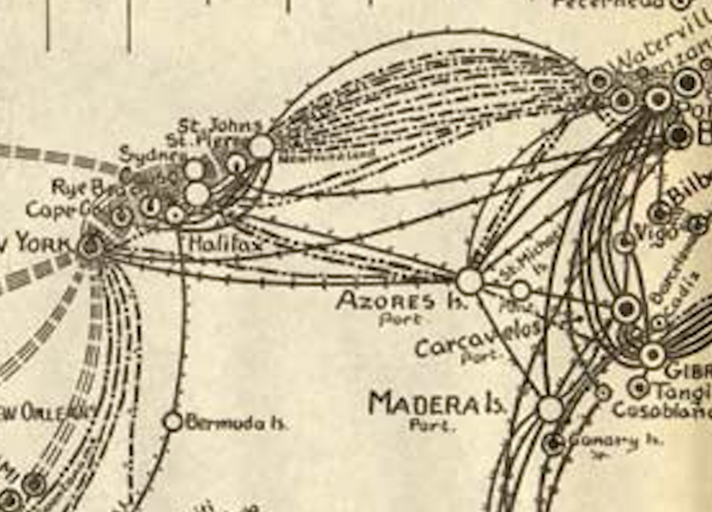
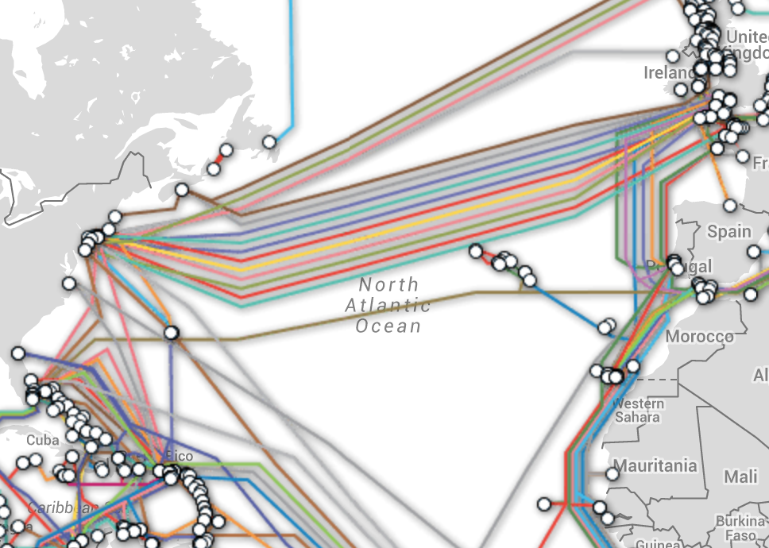
Diversity Myth
Northern Trans-Atlantic
21
15

Slide 34
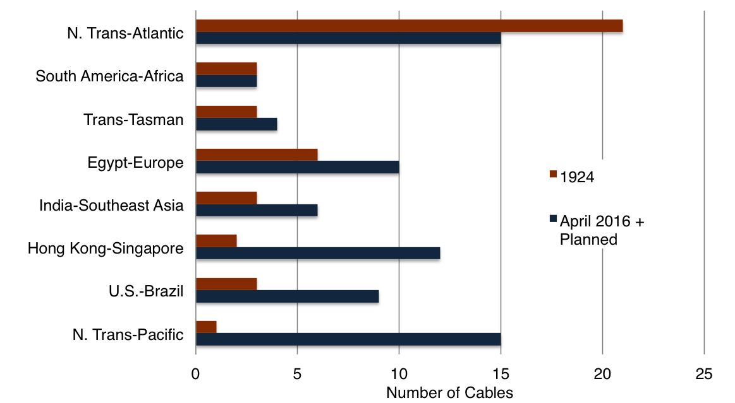
Diversity Myth
And the winner is.....
Source: TeleGeography

Slide 35
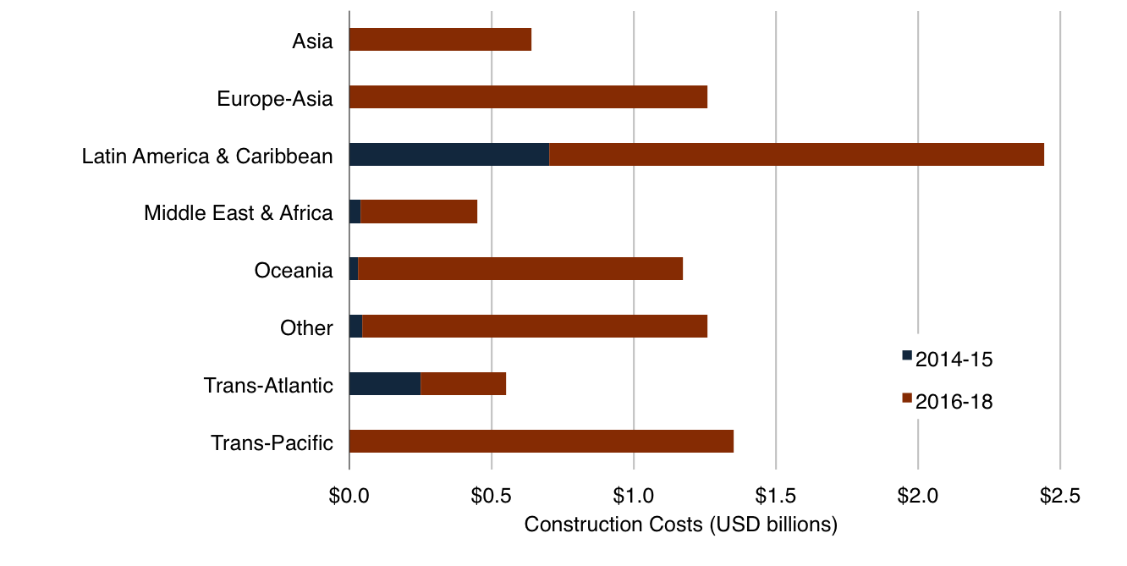
Diversity Myth
Investment Surging in New Systems
Notes: Construction costs based on the year that the cable entered service. Construction costs exclude the cost of subsequent capacity upgrades and annual O&M. 2016-2018 construction costs based on announced contract values and TeleGeography estimates. Not all planned cable may be constructed.
Source: TeleGeography

Slide 36

Diversity Myth
The Myth: The global network has never been more resilient.
Conclusion: Many, but not all, routes have more cables now compared to the age of the telegraph.
Status:

Slide 37
Netflix Myth
The Myth: Netflix has huge subsea capacity requirements
Conclusion: ???
Status: ???

Slide 38
Netflix Myth
Origin of the myth
Netflix does account for a large amount of end-user traffic.
  Netflix accounts for 37% of North American downstream traffic and 20% in the UK and Ireland (Source: Sandvine).
Netflix is expanding rapidly.
  Already in 60 countries now.
  Plans to enter 130 new countries by end of 2016.

Slide 39
Netflix Myth
What does this have to do with submarine cables?
  Not too much.
  Netflix transfers a copy of each file in its library from the U.S. to foreign storage locations 1x during off-peak hours. (Source: Netflix)
  The file is then replicated at Open Connect (Netflix’ CDN) sites in that country.

Slide 40
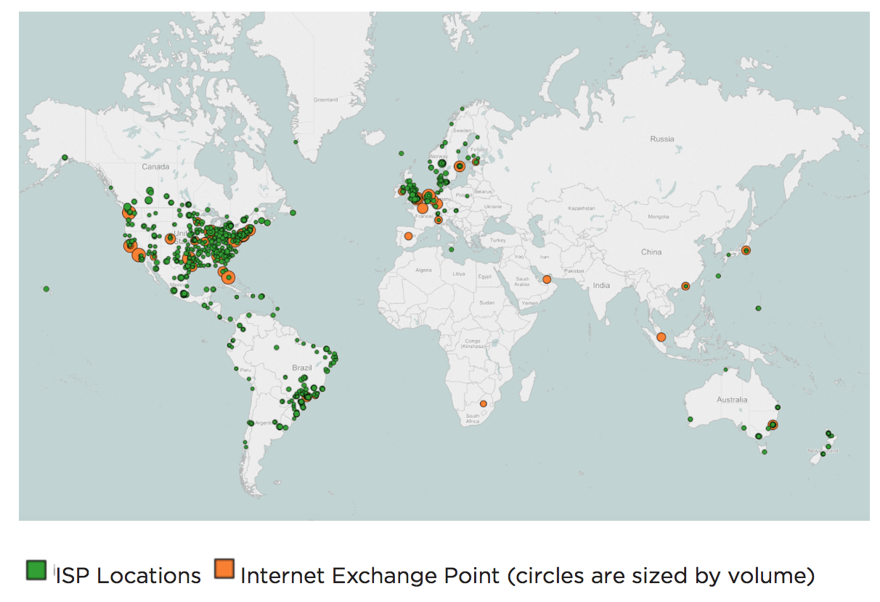
Netflix Myth
Netflix Open Connect Cache Locations
Open Connect Delivers 100% of Netflix traffic
But how much bandwidth is needed to populate the caches?
Source: Netflix

Slide 41
Netflix Myth
Methodology
Gather public data on Netflix library size, file length, and average streaming rate.
Estimate bandwidth requirements needed to refresh 100% of the entire U.S. library of content each month.

Slide 42
Netflix Myth
Total size of Netflix library estimate
Netflix U.S. Library Size – 4,577 movies + 34,771 TV episodes = 39,348 files₁
Average file length – 1 hour ₂
Netflix streaming usage in 1 hour – 4.75 GB₃
39,348 files x 1 hour x 4.75 GB/hour = 186,903 GB
Sources:
http://www.flixed.io/netflix-countries
TeleGeography estimate
http://cordcuttersnews.com/comparing-data-usage-for-netflix-hulu-and-amazon/

Slide 43
Netflix Myth
How much bandwidth is needed?
186,903 GB library size / 30 = 6,230 GB per day (to refresh a cache in month)
6,230 GB a day (just using 12 non-peak hours a day) =
577 Mbps!!!!
Caution:
  Netflix likely does not refresh 100% of the contents of a cache each month.
  The library size outside of the U.S. is considerably smaller, e.g. 50% smaller in the U.K.

Slide 44
Netflix Myth
What if Netflix caches didn’t exist?
Netflix subscribers in the U.K. in 2015 – 4.3 million (Source: OFCOM)
Maximum ISP streaming rate in U.K. – 4.03 Mbps (Source: Netflix)
Total bandwidth required if all U.K. subscribers watched at the same time without caches...
  4.3 million x 4.03 Mbps = 17.3 Tbps (or ~1/3 trans-Atl lit capacity!)

Slide 45
Netflix Myth
The Myth: Netflix has huge subsea capacity requirements.
Conclusion: While Netflix uses a small amount of international capacity, its CDN distributes the vast majority of content.
Status:

Slide 46
Satellite Myth
The Myth: The destruction of a single satellite would cause half of North America to “lose their Facebook”.
Conclusion: ???
Status: ???

Slide 47

Satellite Myth
The Origin of the Myth

Slide 48

Satellite Myth
Space is Dangerous

Slide 49

Satellite Myth
George Clooney to the Rescue
“Half of North America just lost their Facebook.”

Slide 50
Satellite Myth
What if George Clooney was right?
ViaSat-1 – at 140 Gbps is the highest capacity satellite (Source: Guinness Book of World Records)
Offers 12 Mbps service to residential subscribers
Assuming a 10:1 oversubscription rate, the satellite can serve ~120,000 subscribers

Slide 51
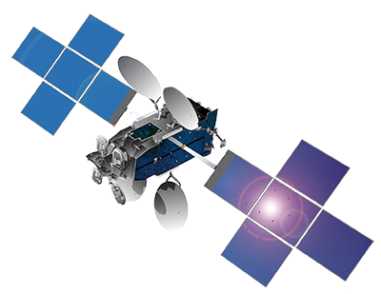
Satellite Myth
What if George Clooney was right?
  85 million
  Half of the number of active daily North American Facebook users December 2015 (Source: Facebook)
  /
  120,000 subscribers per satellite

Slide 52
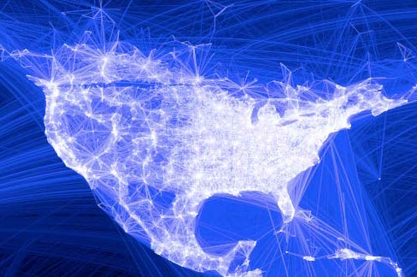
Satellite Myth
730 Satellites
Map Source: Facebook

Slide 53

Satellite Myth
What would this cost?
ViaSat-1 cost: $250 million
George Clooney’s net worth: $250 million

Slide 54
Satellite Myth
$183 billion or 730 George Clooneys!
Map Source: Facebook

Slide 55
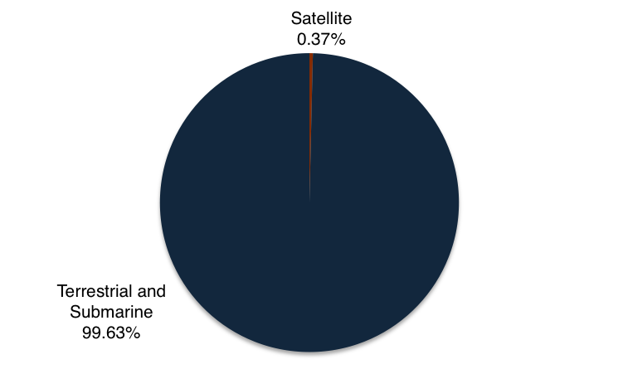
Satellite Myth
Satellites’ Share of International Circuits Connected to the U.S., 2014
Source: FCC, 2014 U.S. International Circuit Capacity Data

Slide 56
Satellite Myth
The Myth: The destruction of a single satellite would cause half of North America to “lose their Facebook”.
Conclusion: George Clooney is very charming, but he doesn’t know how the Internet works.
Status:

